Slide 1
MyExperience
Physician Experience
Notes:
Cerner is committed to improving physicians’ experience through health information technology.

Slide 2


Key Functions
Allows administrators to enable users to switch among predetermined sets of positions, default views and MPages/ViewPoints.
Allows a user to change their position, default view and MPages/ViewPoints for the current specialty they are practicing.
Notes:
Change your view when you need to
- If a physician has multiple specialties, he or she no longer needs to go to IT to change the view. MyExperience allows them to change their view on their own.

Slide 3
MyExperience User Console
End users switch positions, default views and MPage views from within PowerChart

Slide 4
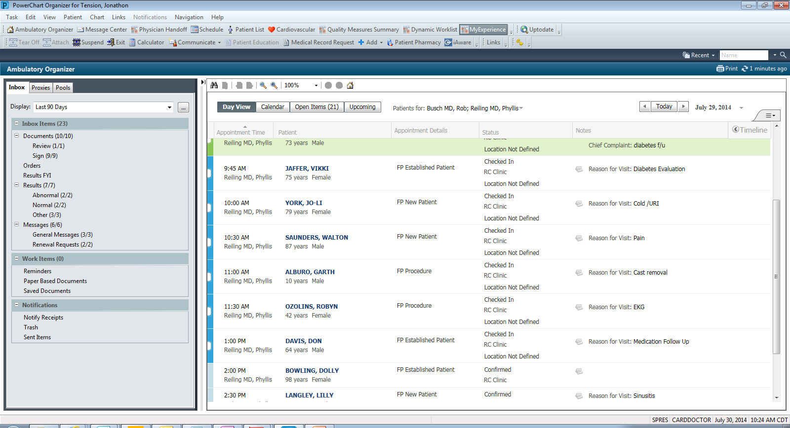
Dr. Tension logs in. The default organizer view is Ambulatory Organizer. Click the MyExperience organizer level MPage in the organizer toolbar.

Slide 5
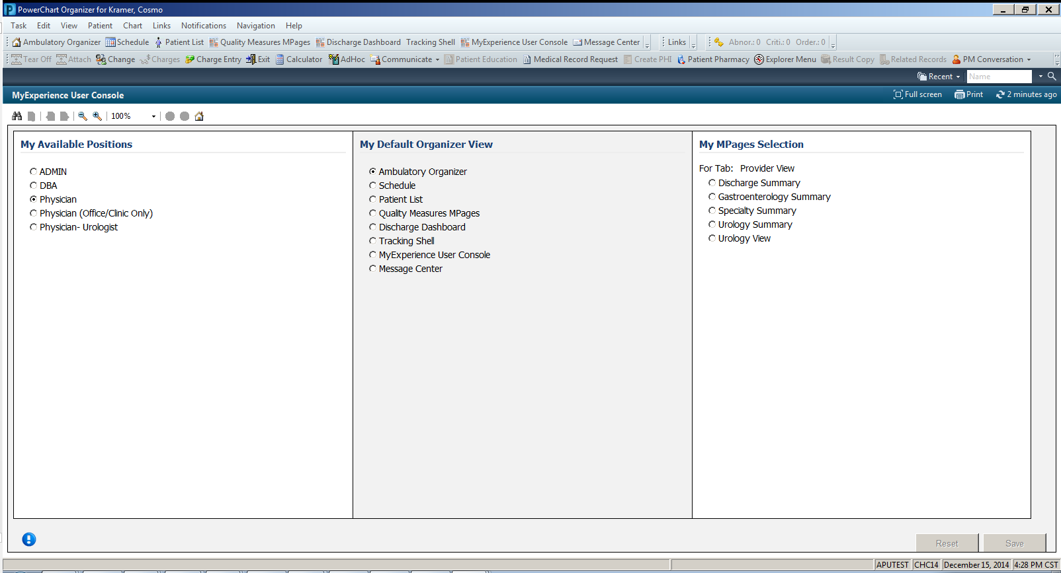
The current position is Physician and default view is Ambulatory Organizer. The My Available Positions list displays all positions related to the role the user is assigned by the administrator.

Slide 6
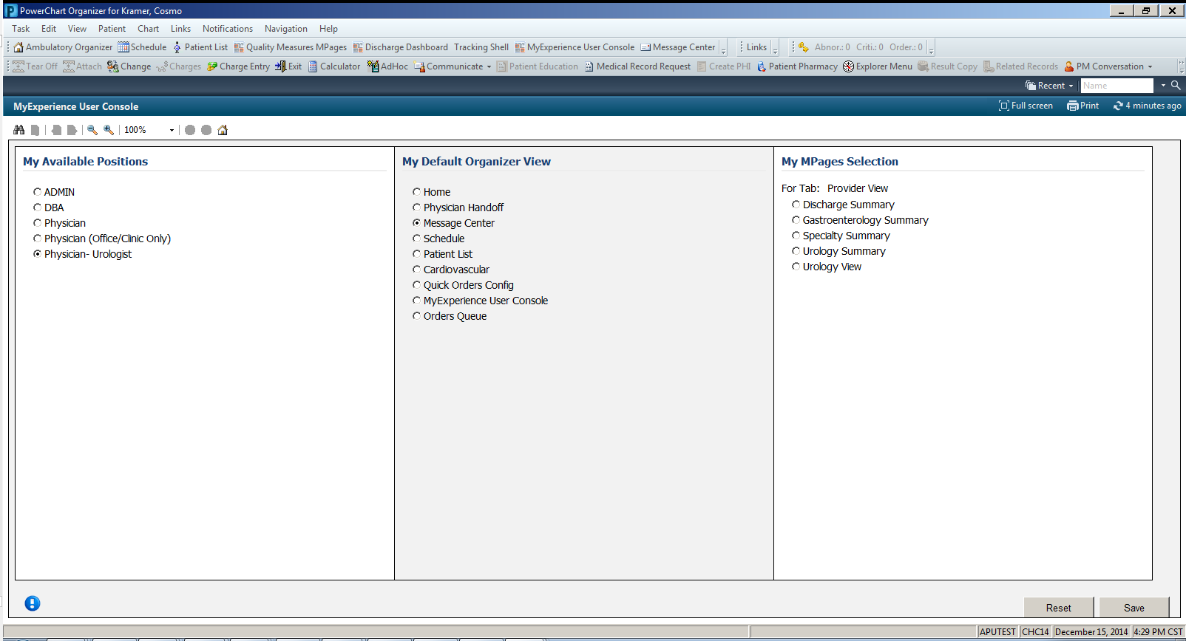
Switch your position to Physician – Urologist. The My Default Organizer View list changes to include the organizer views available on the newly selected position.

Slide 7

Switch the default organizer view to Physician Handoff.

Slide 8
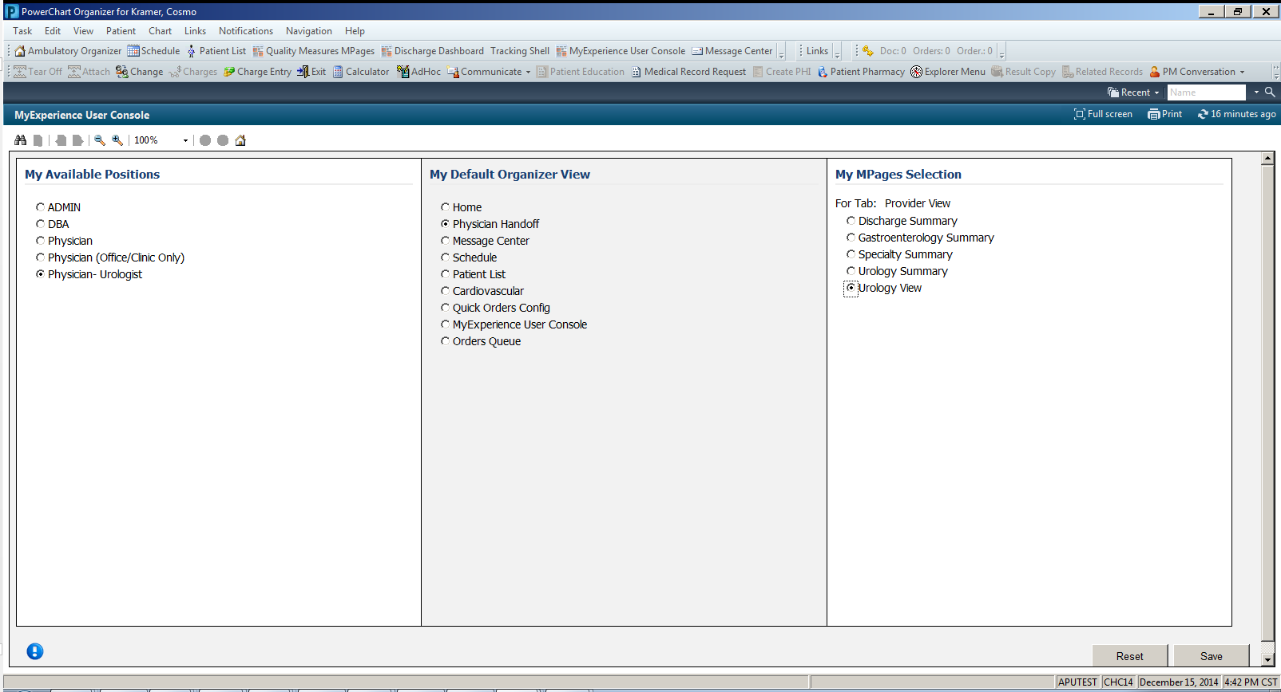
Click Save to make the changes.

Slide 9
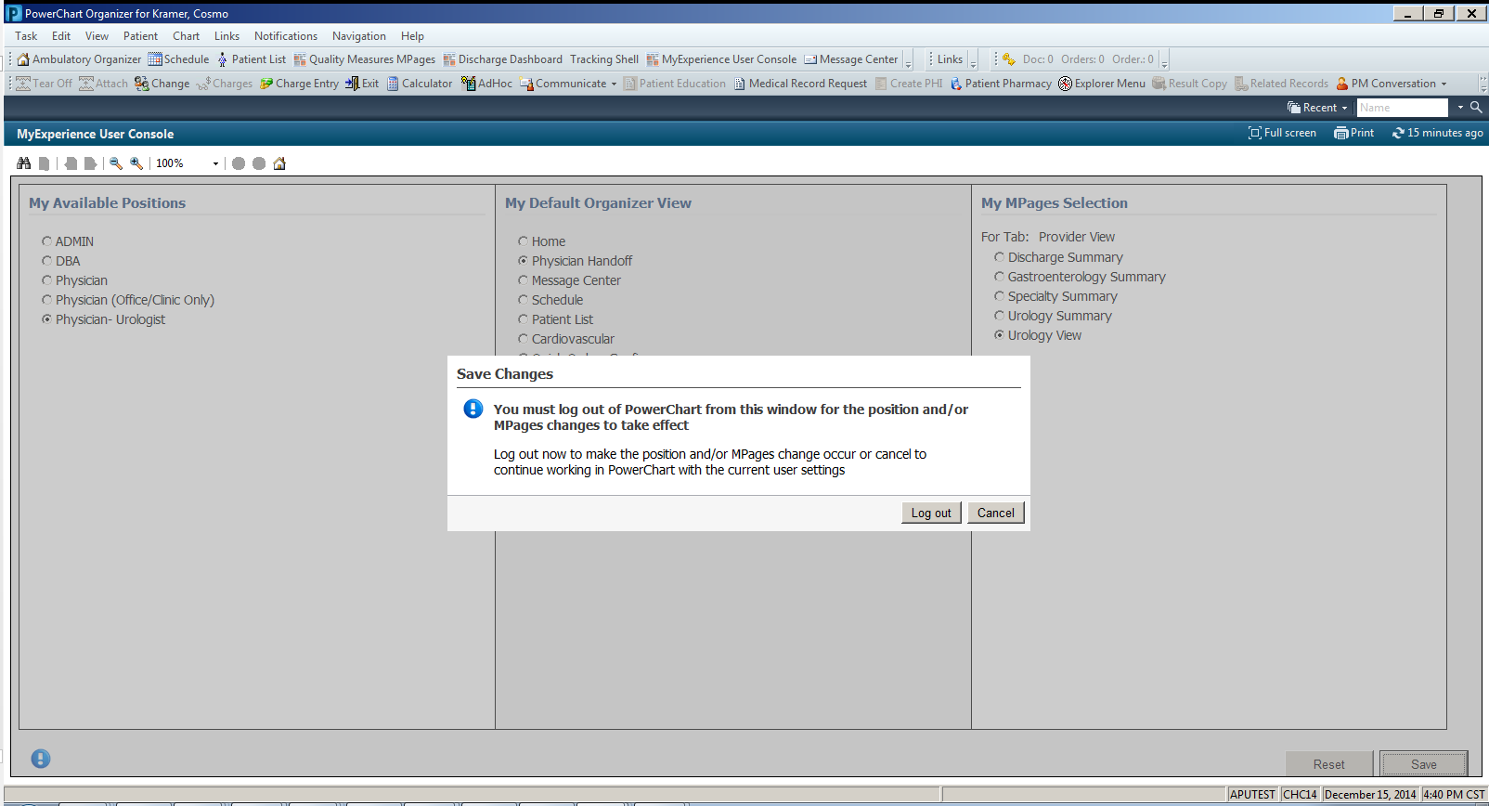
Log out for the changes to take effect.

Slide 10
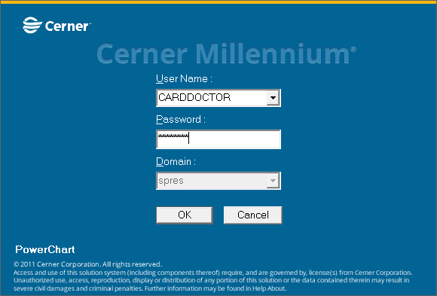
A log in prompt automatically presents and the User Name is already there.

Slide 11
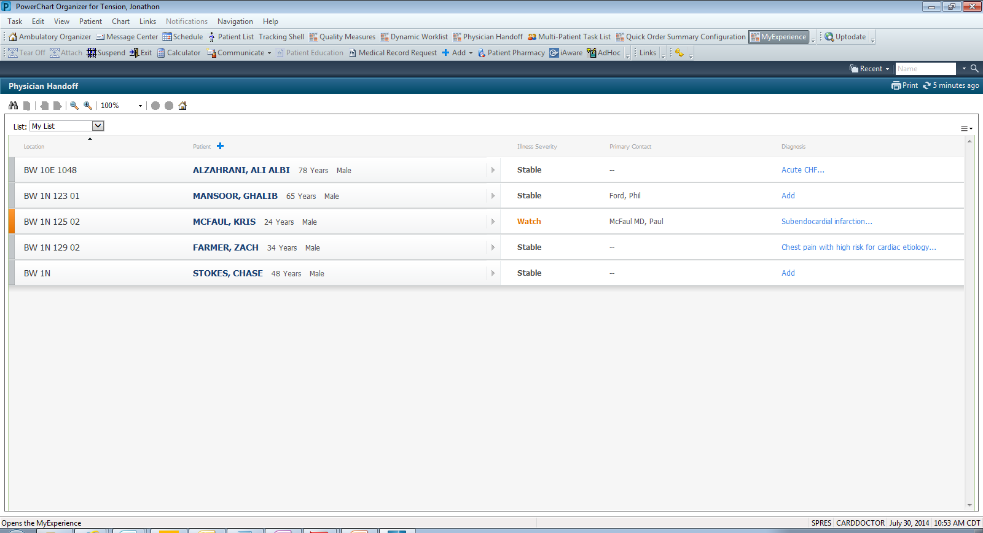
The default organizer view is now Physician Handoff. Click the MyExperience view.

Slide 12
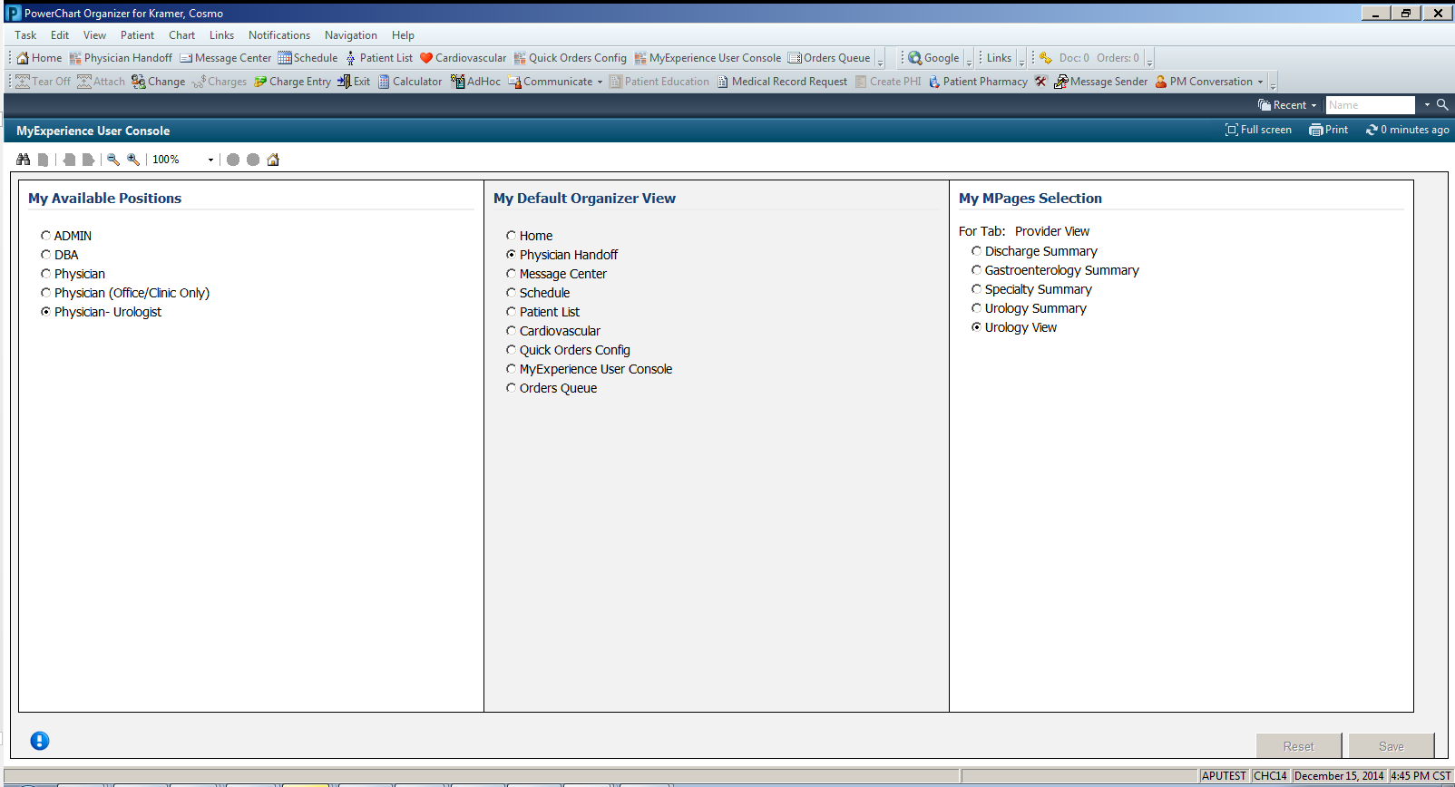
The new position and default view shows as the current setting for that user.

Slide 13
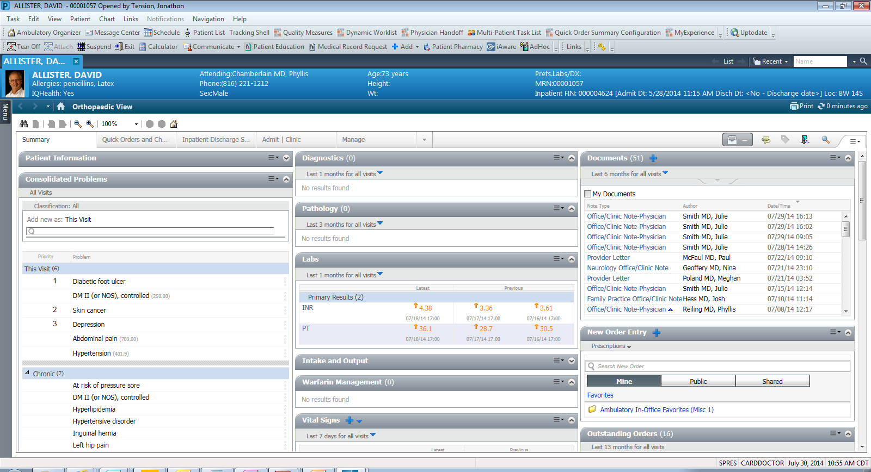
Dr. Tension now has access to the specialty position build and/or specialty viewpoint, depending on what was changed in the User Console.

Slide 14
Configuring MyExperience 1.1

Slide 15
HNAUser
Build roles, add related positions, configure MyExperience at the position level

Slide 16
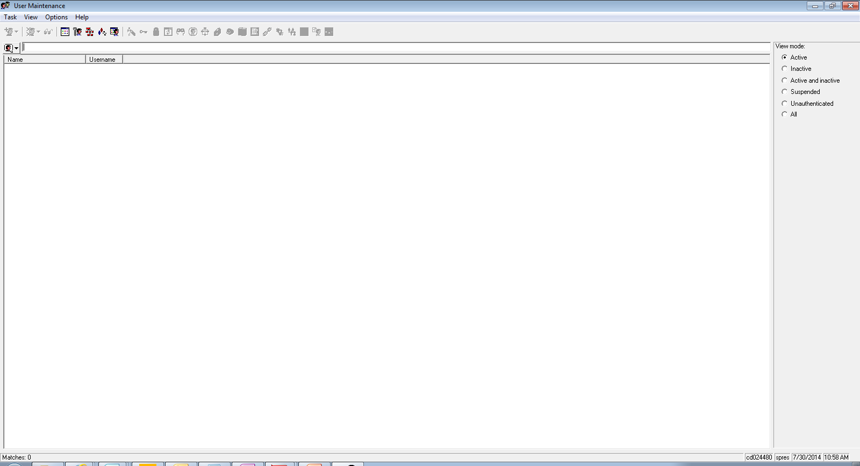
The administrator can relate positions to roles. If MyExperience is configured at the position level, this allows a user within a position of that role to switch among any other positions of that role.

Slide 17
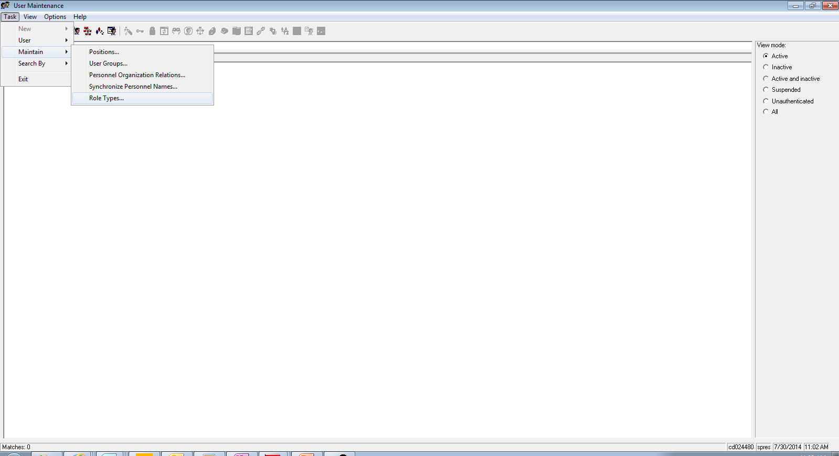
To build the role, select Task > Maintain > Role Types.

Slide 18
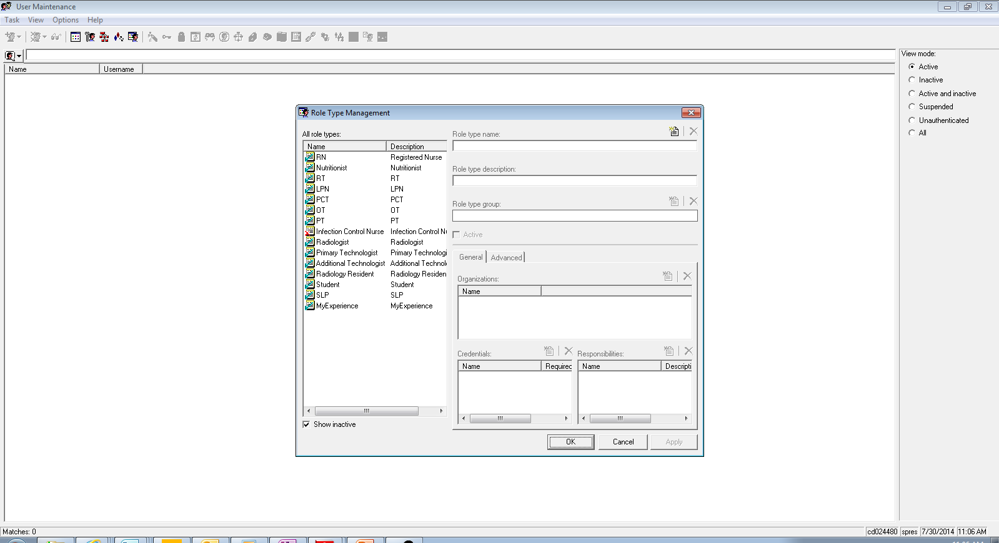
Select the role you want to build out with the positions the user can switch among.

Slide 19
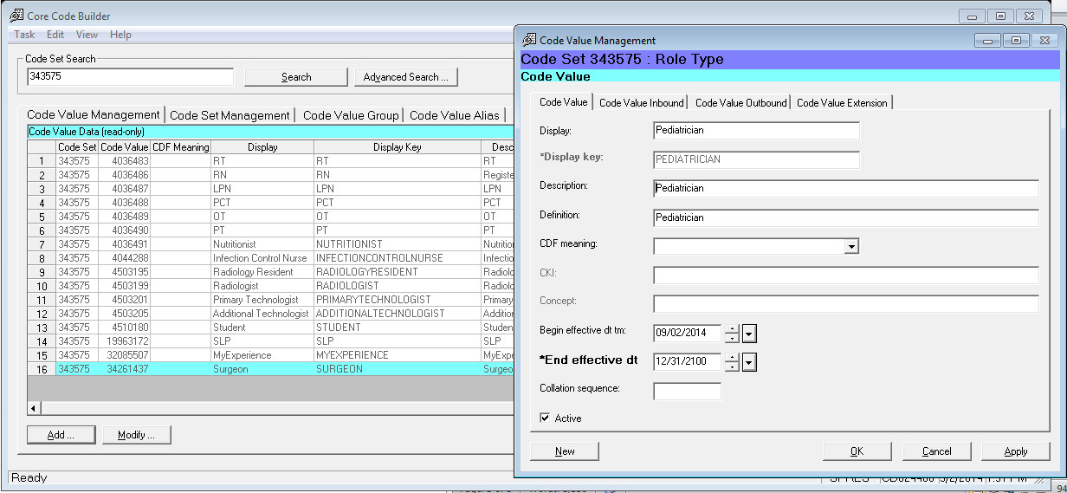
To build a role that is not in the standard content, you can add a code value to codeset 343575.

Slide 20
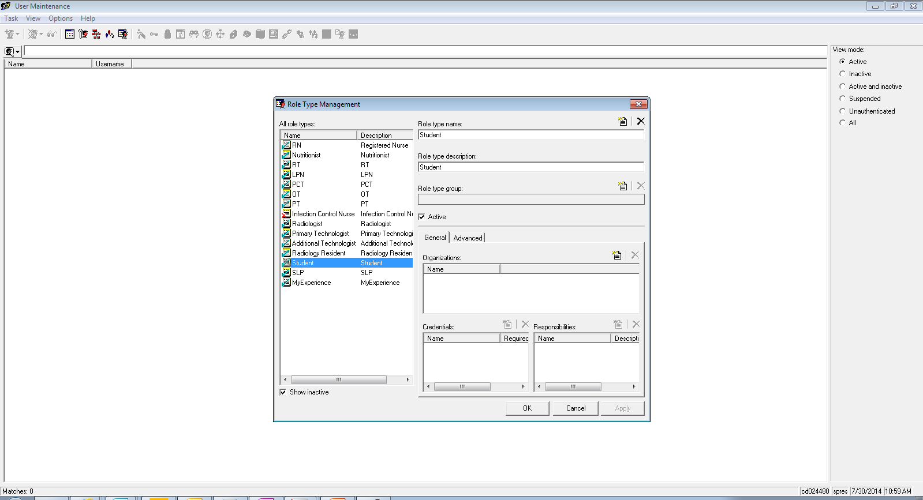
Select the Advanced tab to view the related positions within that role.

Slide 21
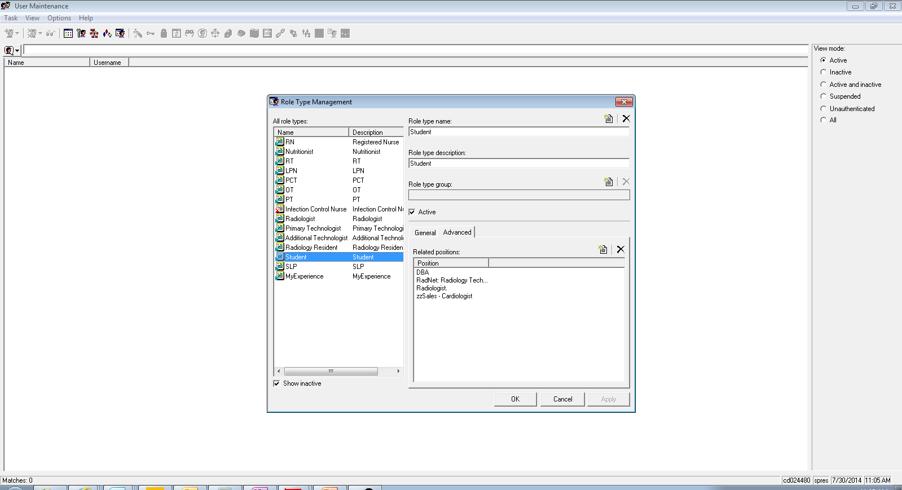
Select the Add Position icon to add a new related position to that role.

Slide 22
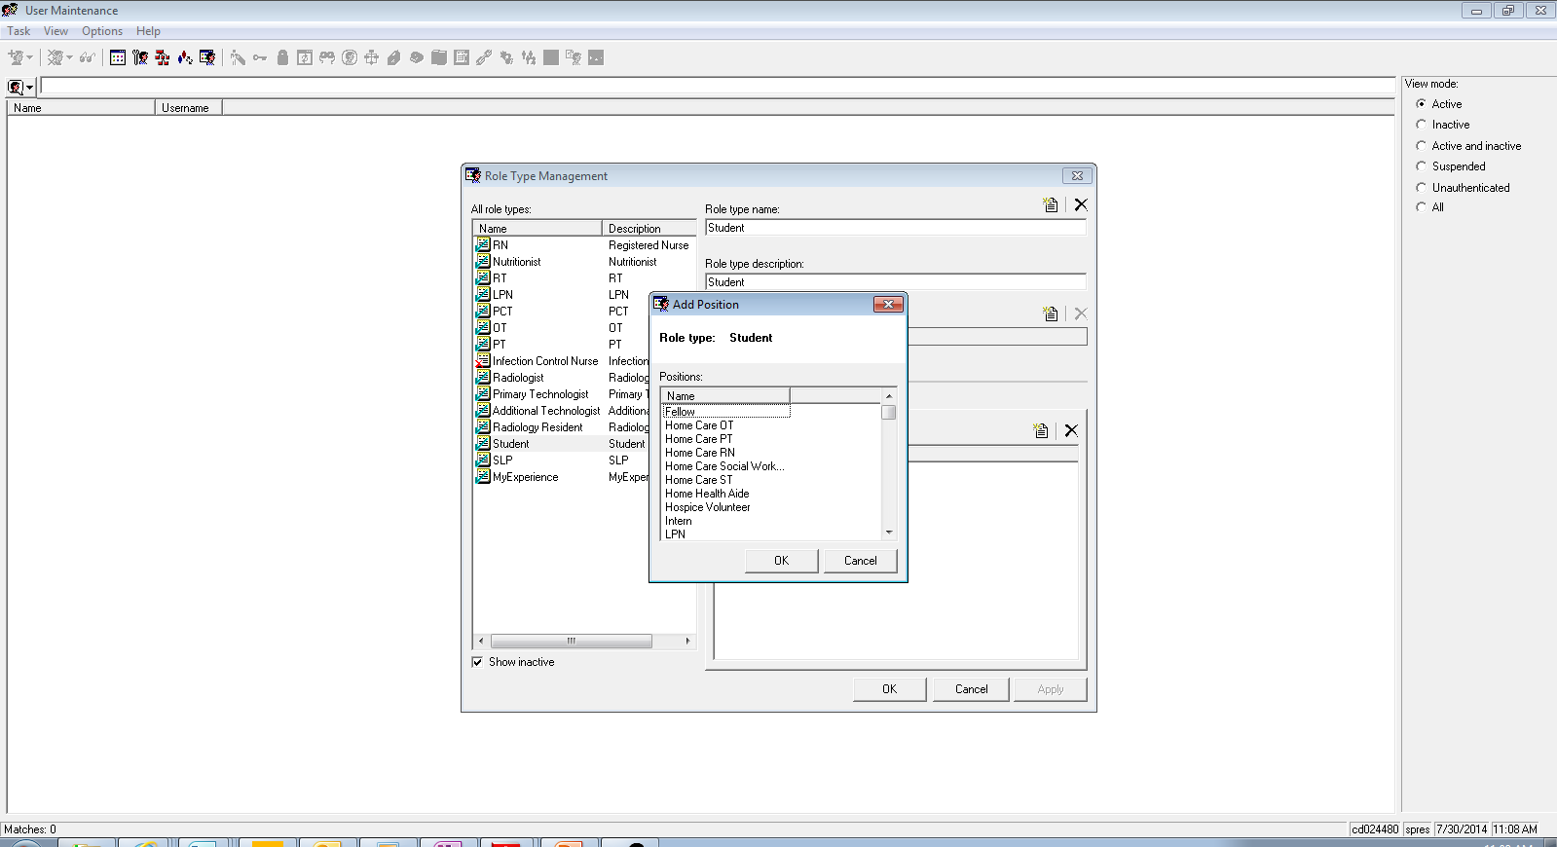
Click Name to organize the list in alphabetical order.

Slide 23
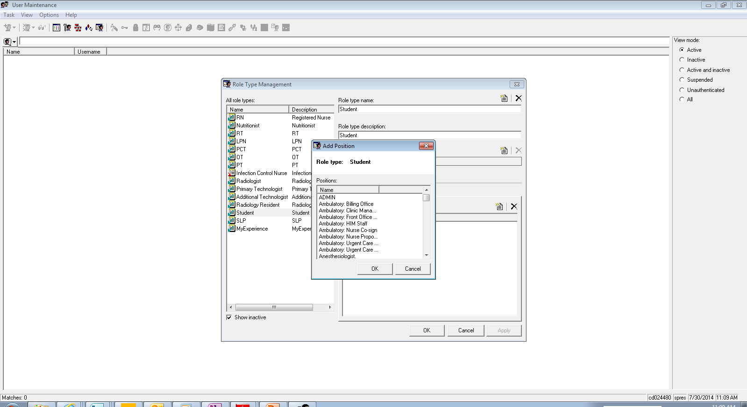
Scroll down to find the position you want to add.

Slide 24
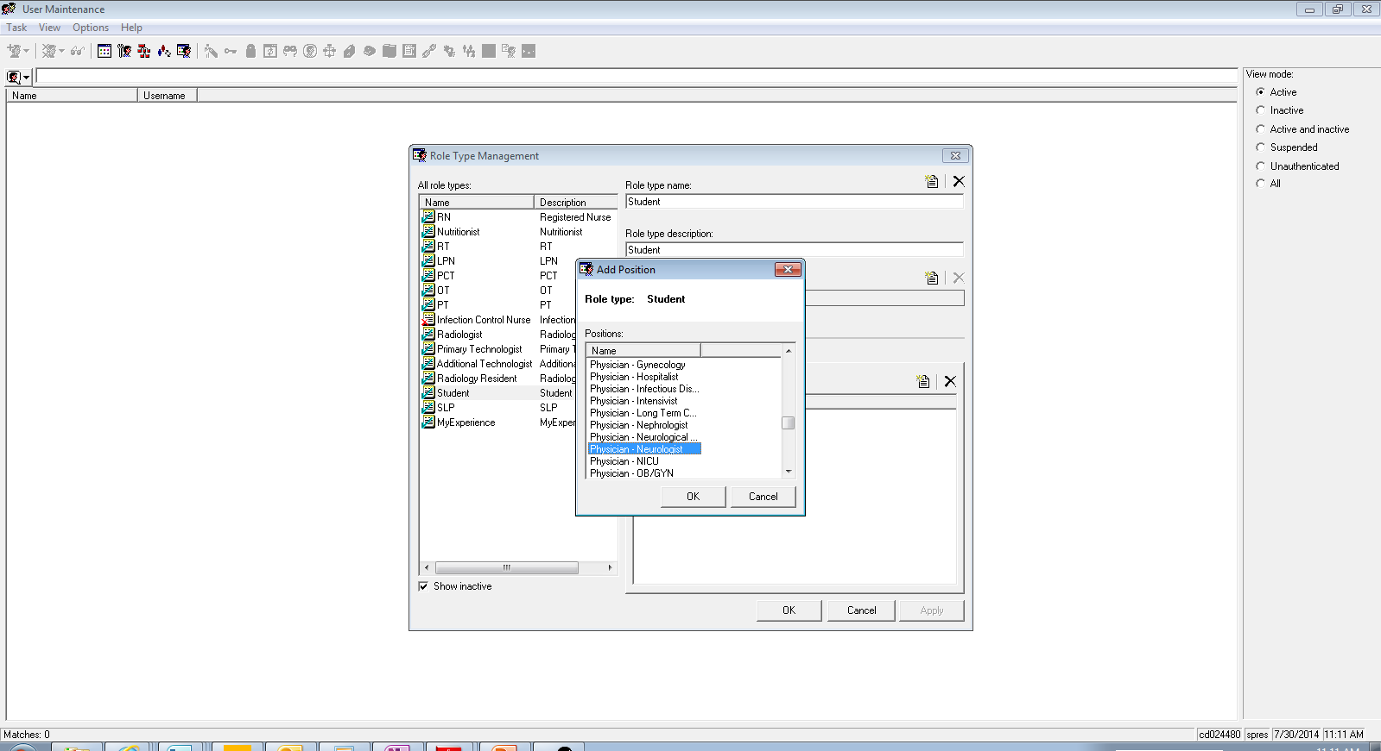
Select the Physician – Neurologist position.

Slide 25
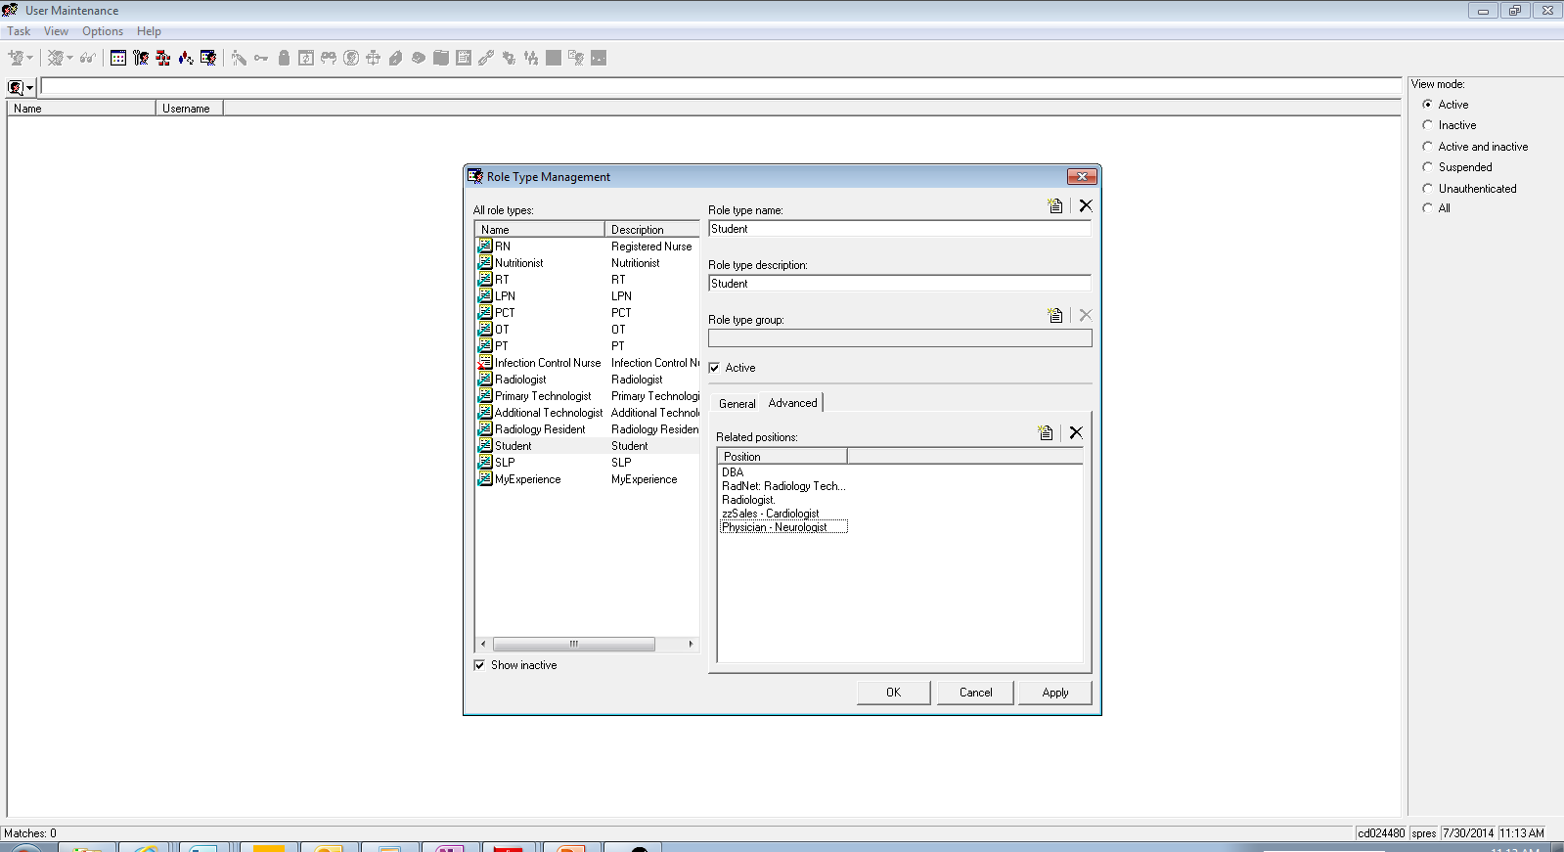
The Physician – Neurologist position is added to related positions. Select Apply. Users in the Physician – Neurologist position can now switch among all other related positions of that role. Users in the other related positions can now switch to Physician – Neurologist.

Slide 26
HNAUser
Configure MyExperience at the User Level

Slide 27
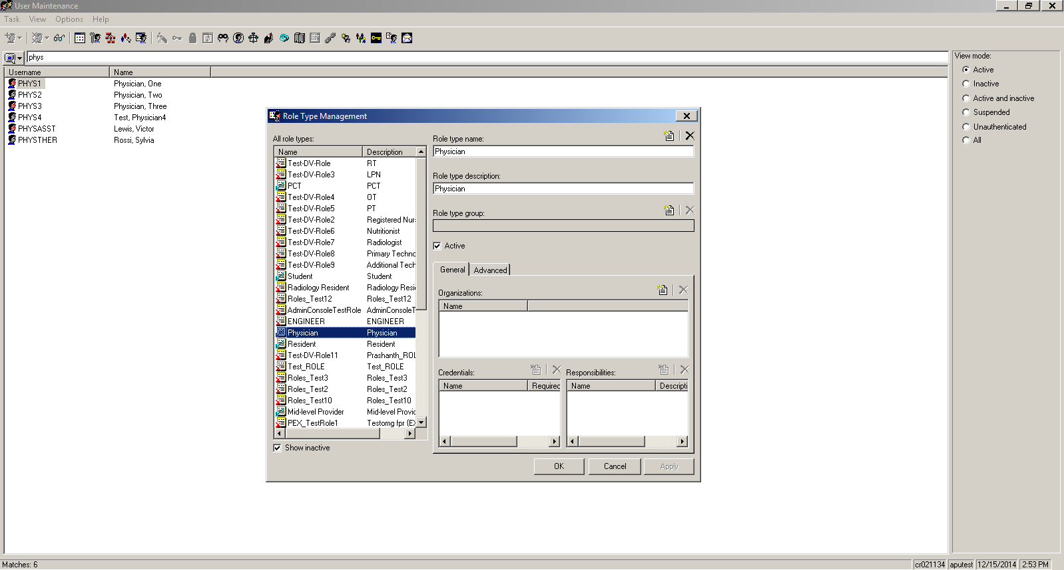
Configuring MyExperience at the user level can enable only specific users to switch among positions related to the user’s role. First, open Role Type Management.

Slide 28
Select the role you want to assign users to. Under the General tab, click the paper icon to add an Organization.

Slide 29
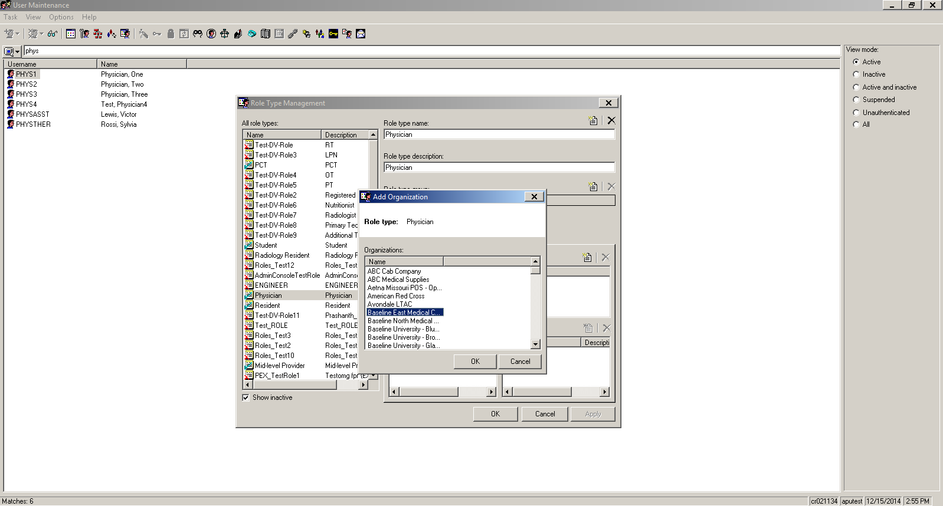
Select the appropriate location for the role and click OK.

Slide 30
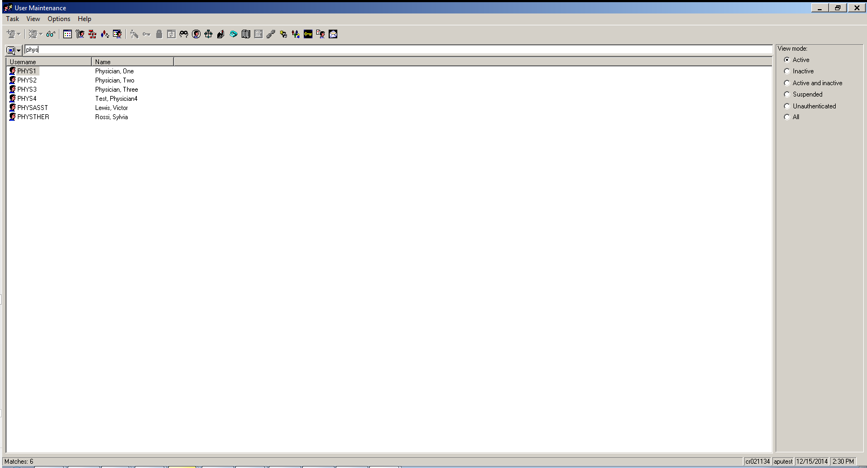
Search for the user you want to assign to the role. Right click on the user.

Slide 31
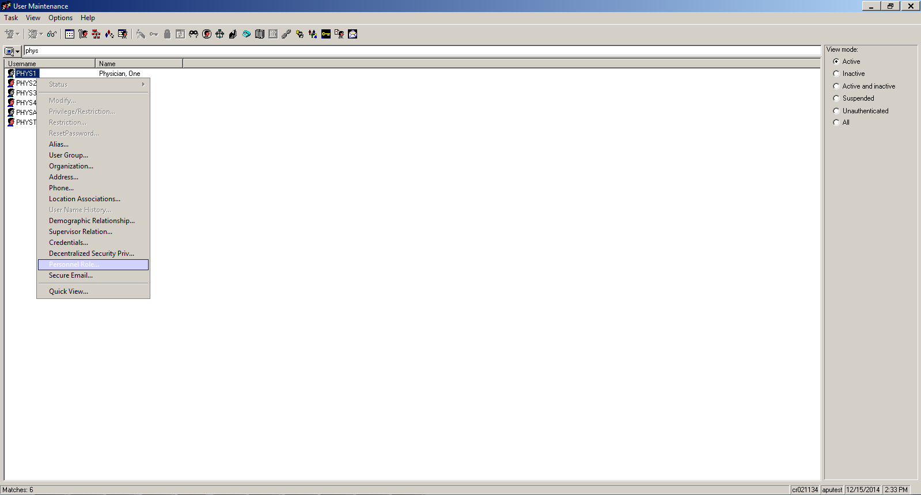
Select Personnel Role from the menu.

Slide 32
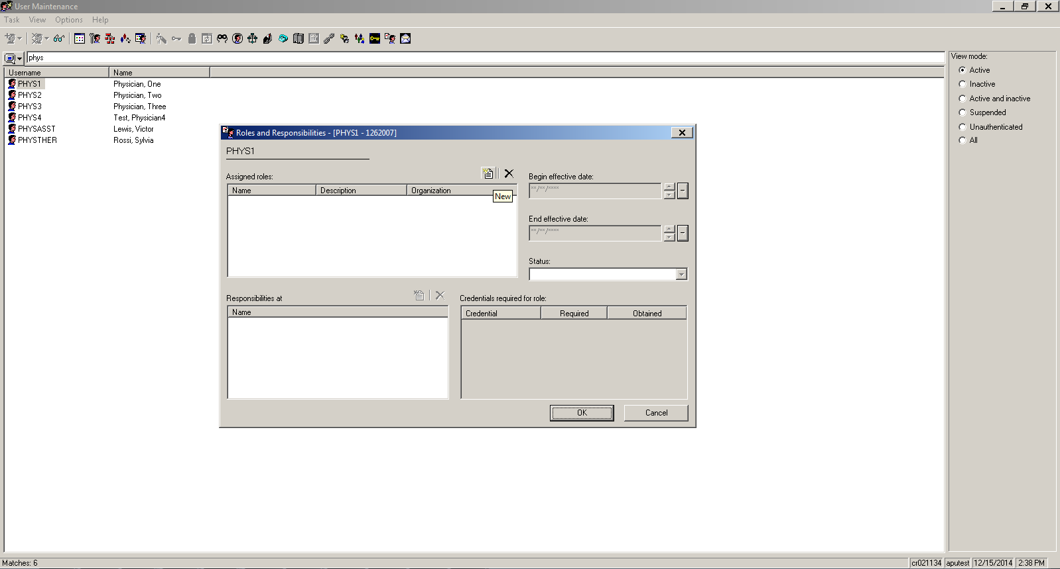
In the Roles and Responsibilities window, click the New icon.

Slide 33
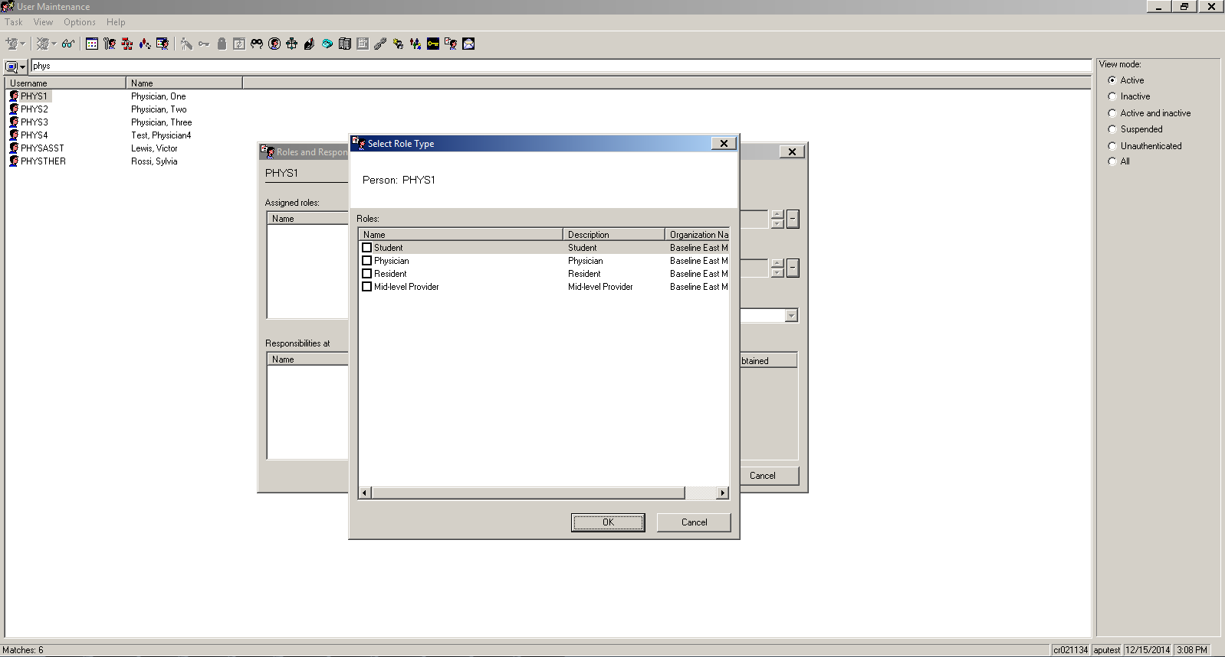
All the active roles with organizations added to them appear here. Check the role(s) to assign to the user.

Slide 34
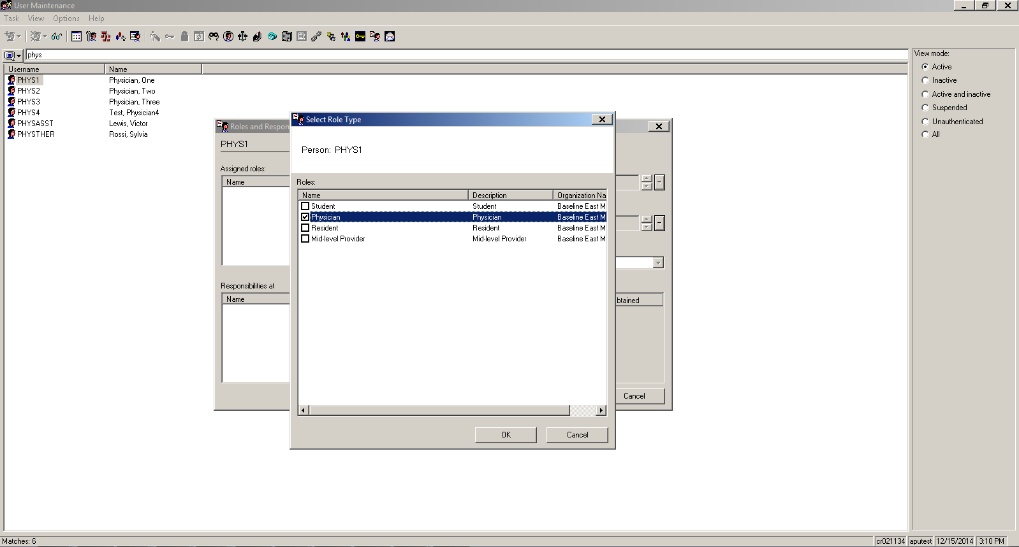
Select OK. The user is now assigned to this role.

Slide 35
MPages Definition Manager
Define all MPages that you will allow users to switch among in MyExperience.

Slide 36
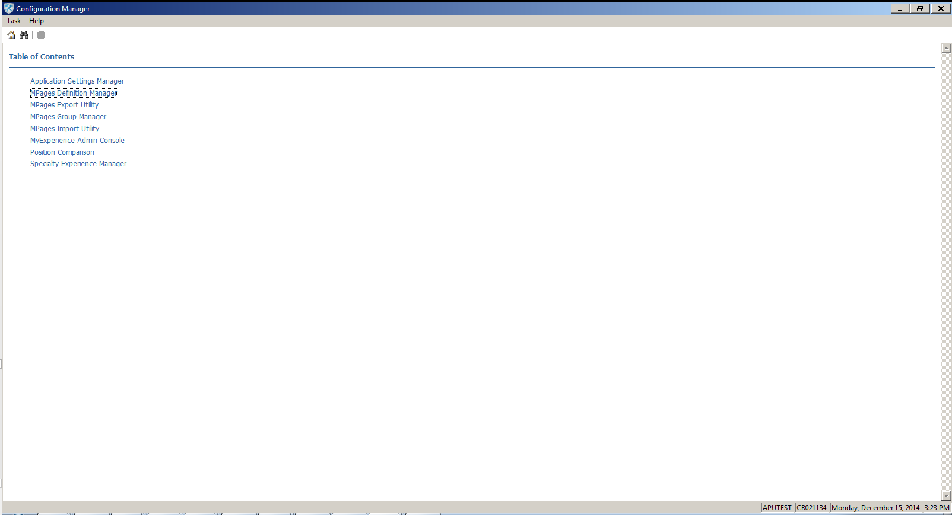
MPages Definition Manager is accessed through Configuration Manager.

Slide 37
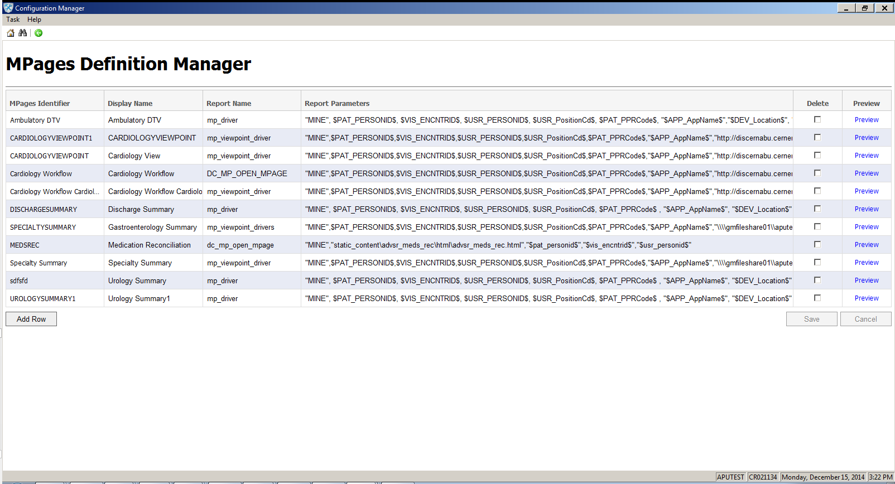
This utility is like a library where you enter the names and parameters for MPages.

Slide 38
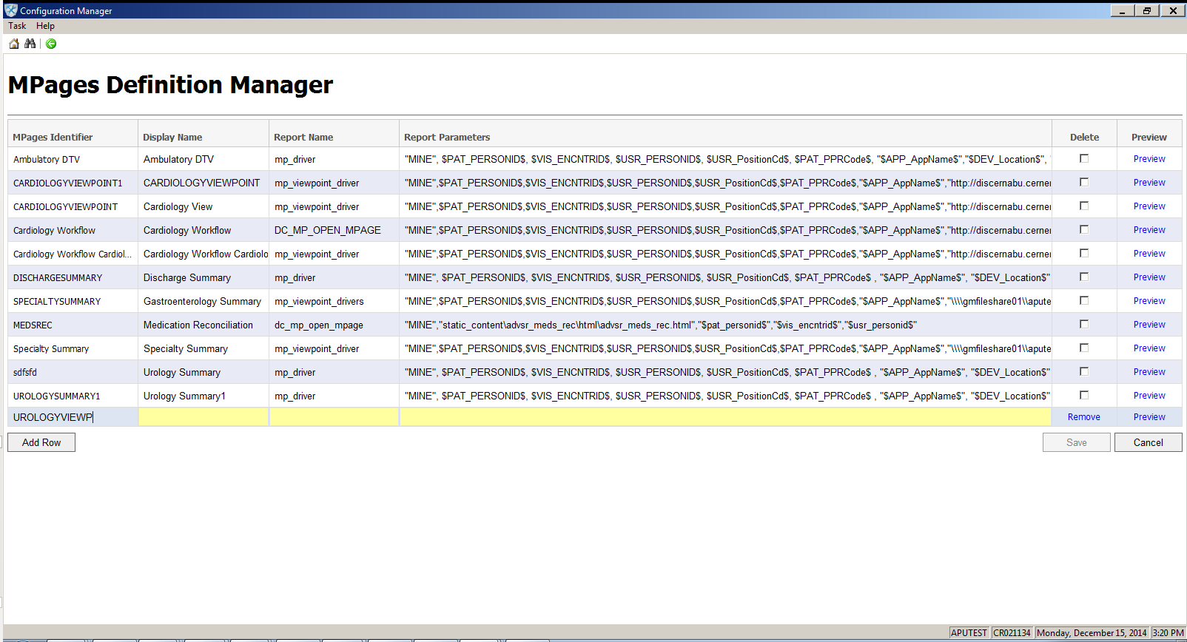
Select Add Row. Enter all information. MPage identifier must be unique.

Slide 39
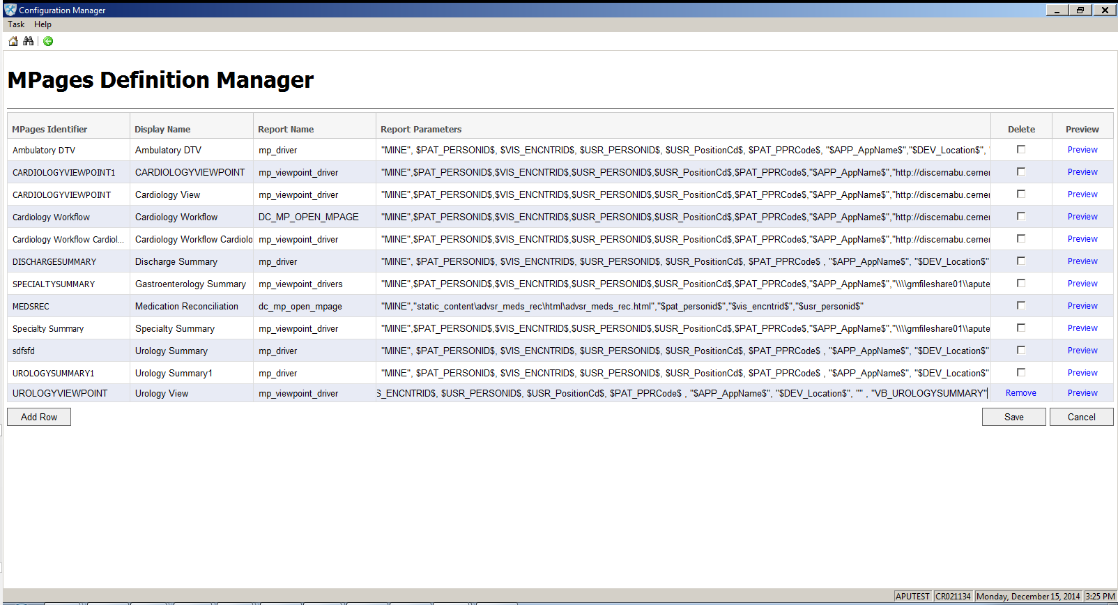
Select Preview.

Slide 40
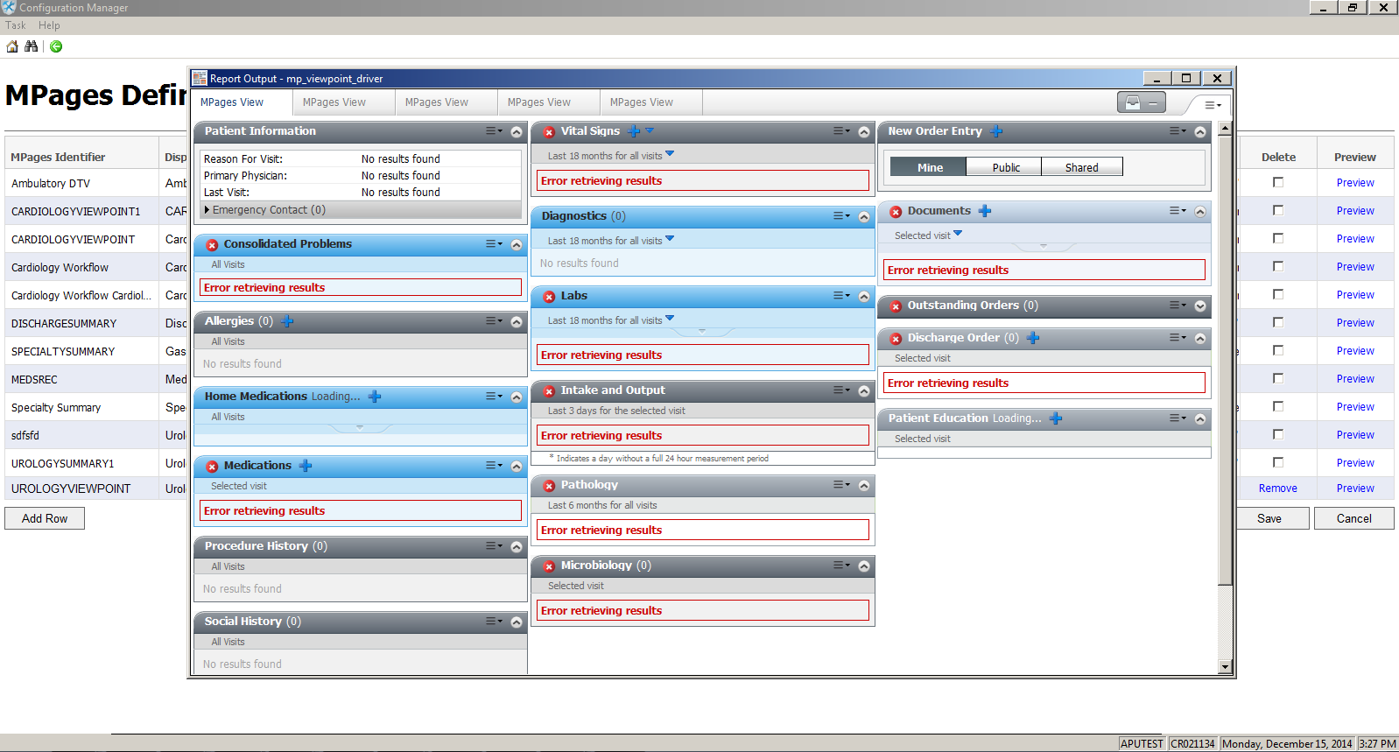
Check to make sure the MPage displays and the parameters are correct. Also check the correct number of tabs (if it’s a ViewPoint) and components display. The MPage preview will not pull in patient data so many components will show errors.

Slide 41

Click Save.

Slide 42
MPages Group Manager
Enable roles to switch their positions and organizer views

Slide 43
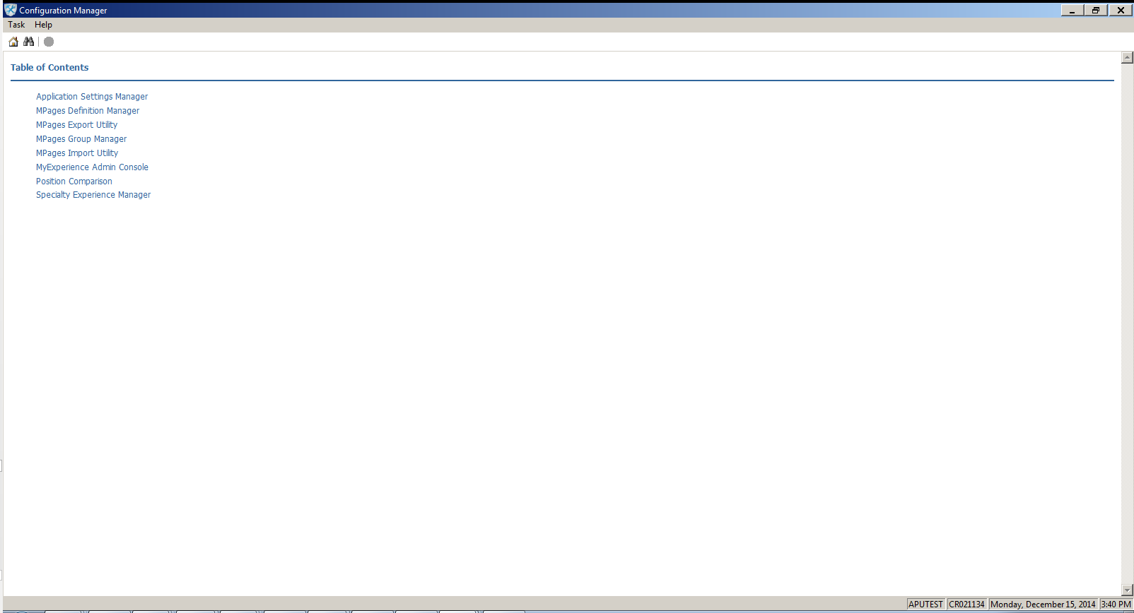
MPages Group Manager is accessed through Configuration Manager.

Slide 44
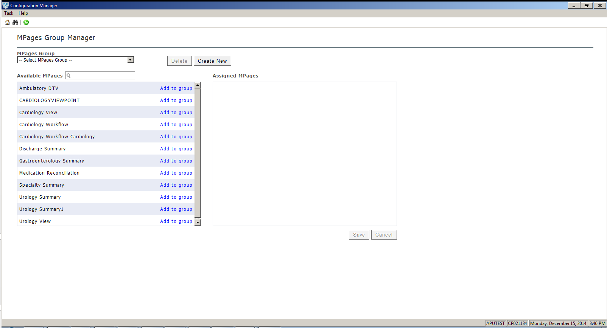
In this utility you can create groups of MPages from MPages Definition Manager as you need to accommodate the MPage switching needs of specific roles. Select Create New.

Slide 45
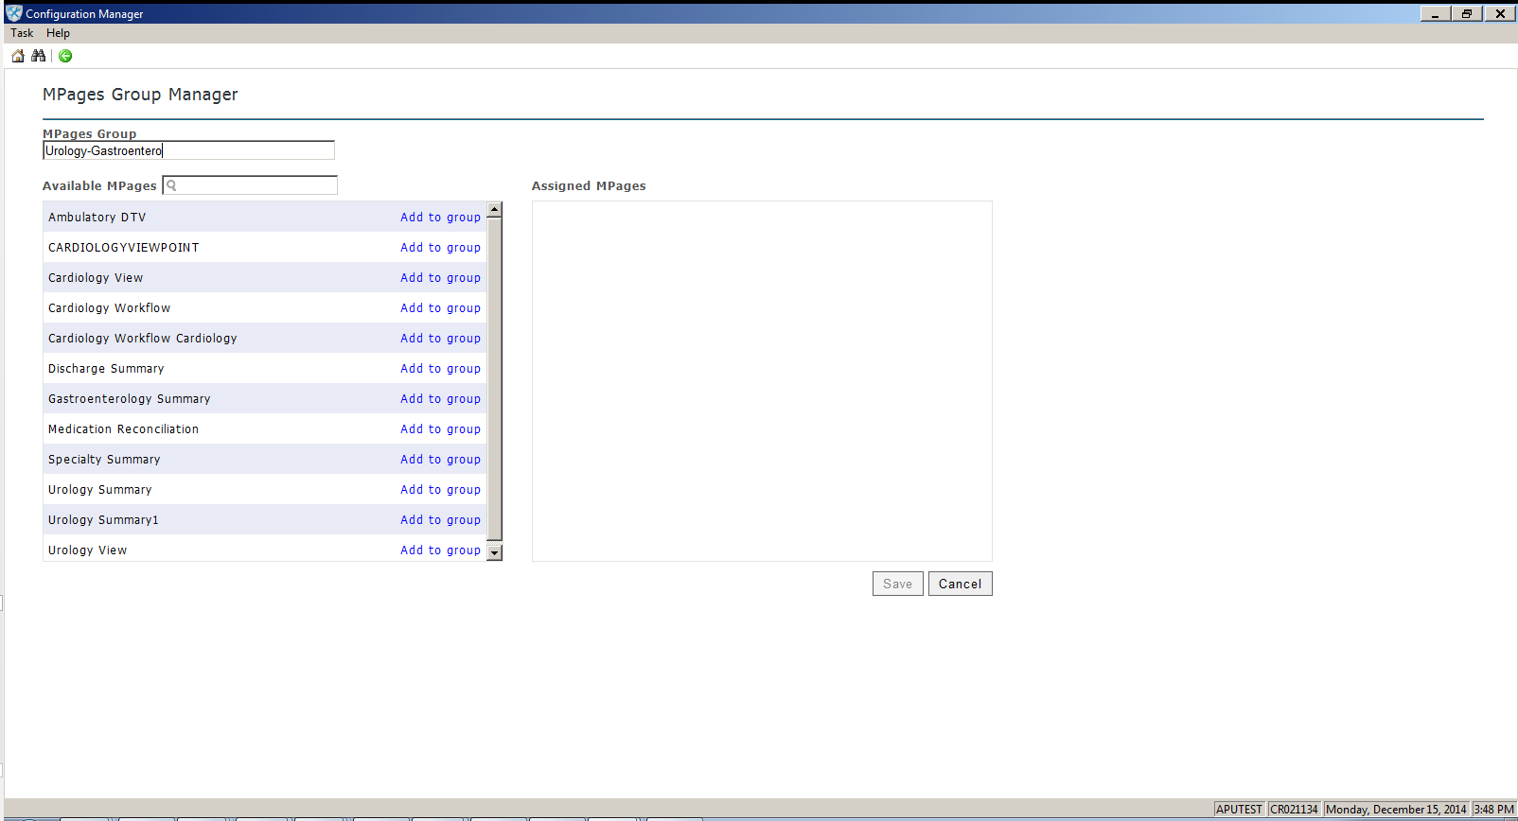
Enter the MPages group name.

Slide 46
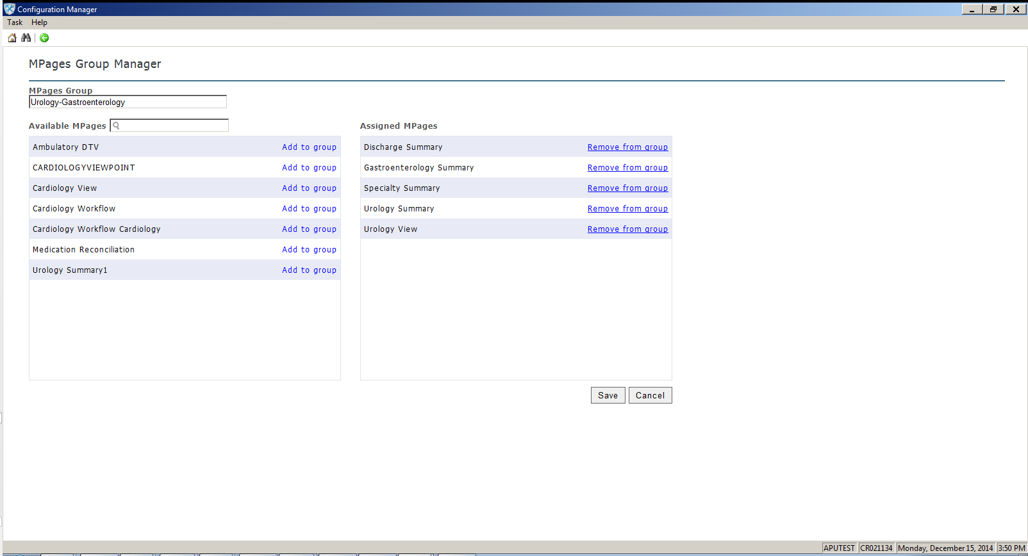
Select “Add to group” for all MPages within the Available MPages box you want to add to the group. The MPages move into the Assigned MPages box.

Slide 47
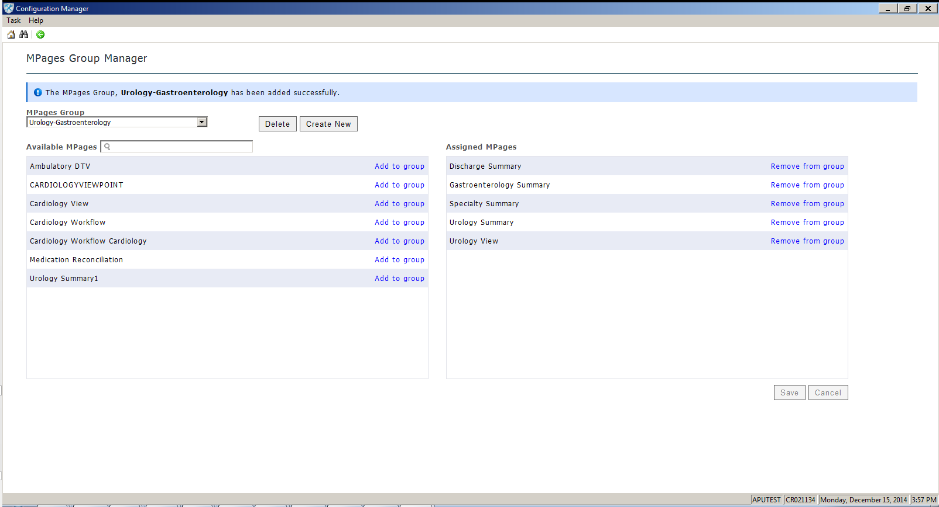
Select Save. You will see a message that your group was added successfully.

Slide 48
MyExperience Admin Console
Enable roles to switch their positions, organizer views and MPage views

Slide 49
MyExperience Admin Console is accessed through Configuration Manager.

Slide 50
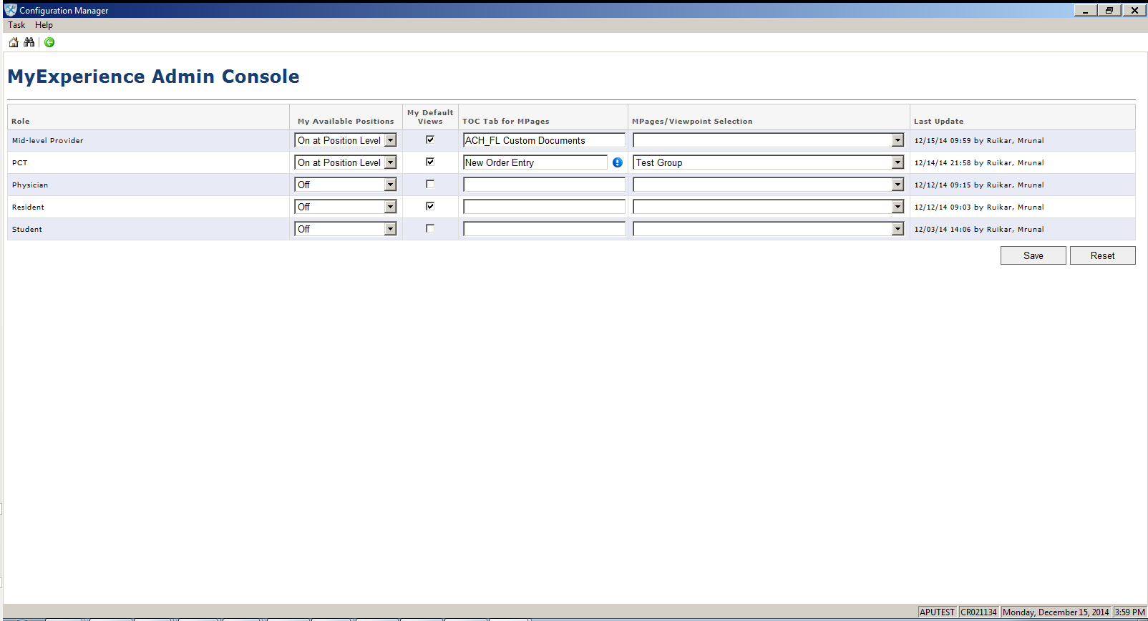
The administrator can enable position, default view or MPage view switching for roles.

Slide 51
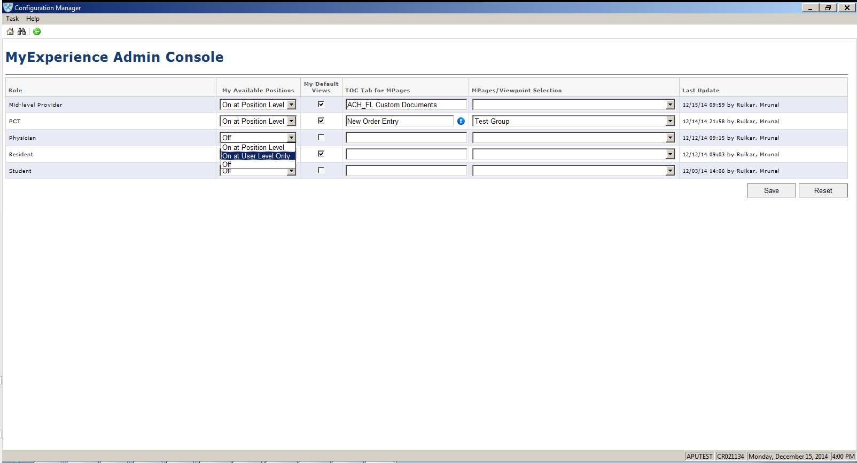
To configure position switching for a role, select an option from the dropdown.

Slide 52
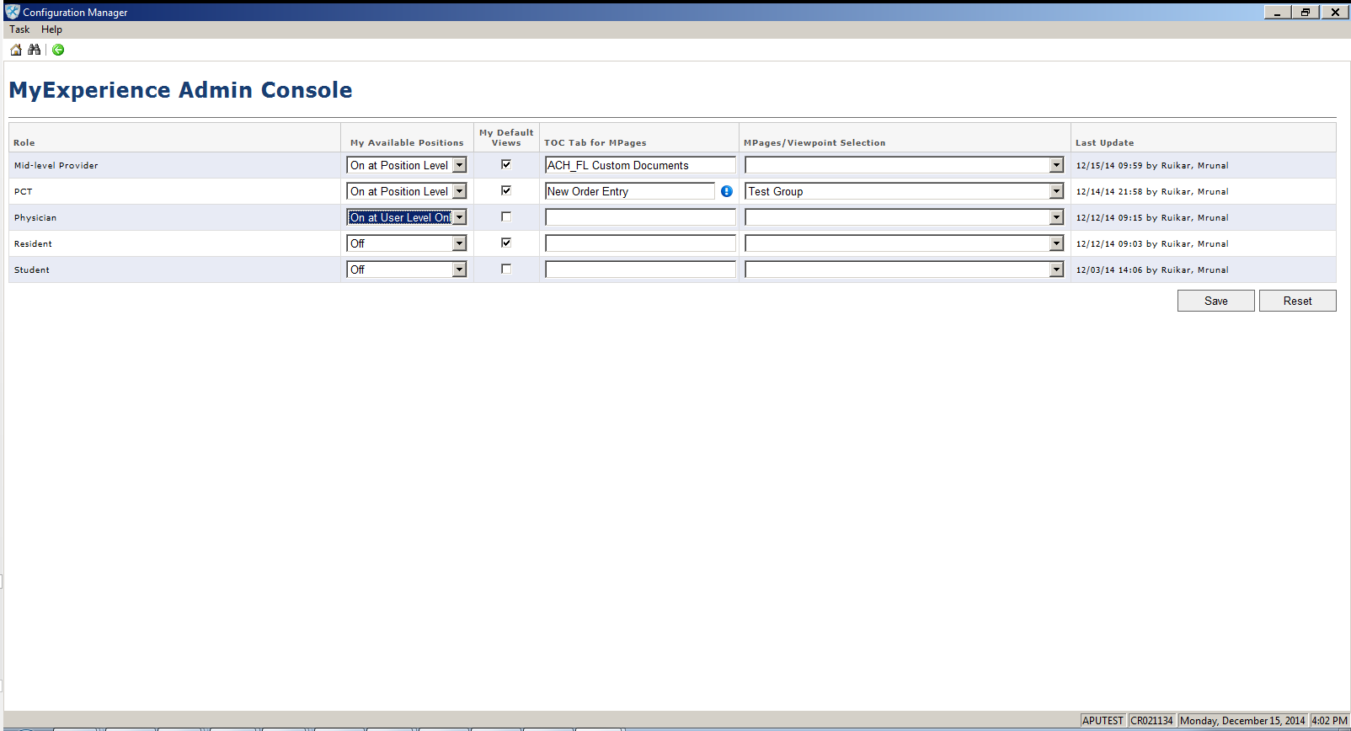
Select “On at Position Level” if configured at the position level or “On at User Level” if configured at the user level (specific users were assigned to the role). If “Off” is selected, the My Available Positions list will be hidden in the MyExperience User Console.

Slide 53

Check or uncheck My Default Views to enable or hide default view switching in the MyExperience User Console.

Slide 54

To configure MPage switching, carefully enter the name of PowerChart TOC tab where users will switch their MPage/ViewPoint into. This tab should be designated for MPage switching and contain a generic name like “Provider View.” If positions are related to the role that have that tab, the tab name will appear as a suggestion as you start to type it.

Slide 55
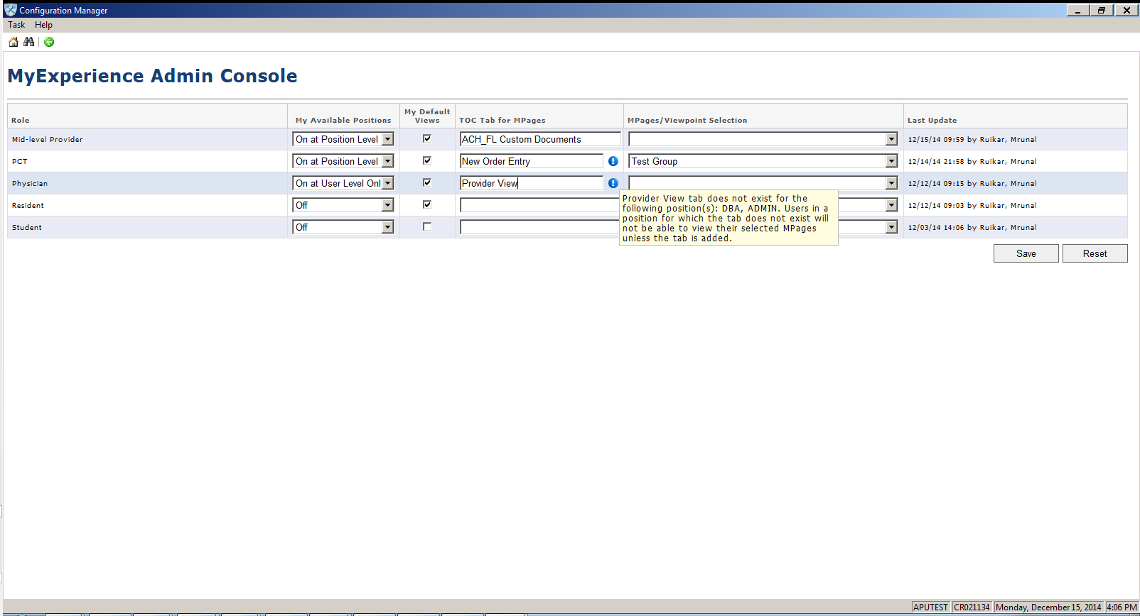
Make sure the chosen tab is added to all positions related to the role and the positions of all users assigned to the role. If positions related to the role do not have the tab name, you will receive an info note that identifies those positions and warns users in those positions will not be able to see MPages they switch into unless the tab is added.

Slide 56
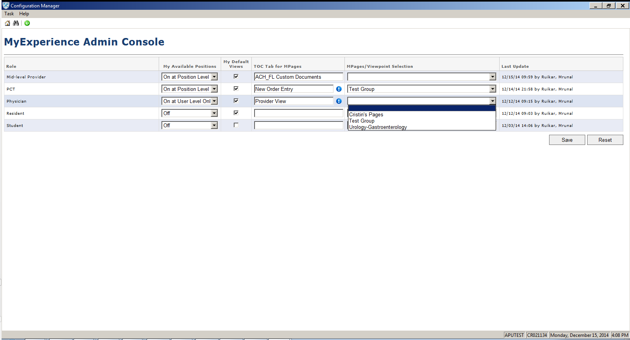
Under MPages/ViewPoint Selection, select the appropriate group from those created in MPages Groups Manager.

Slide 57
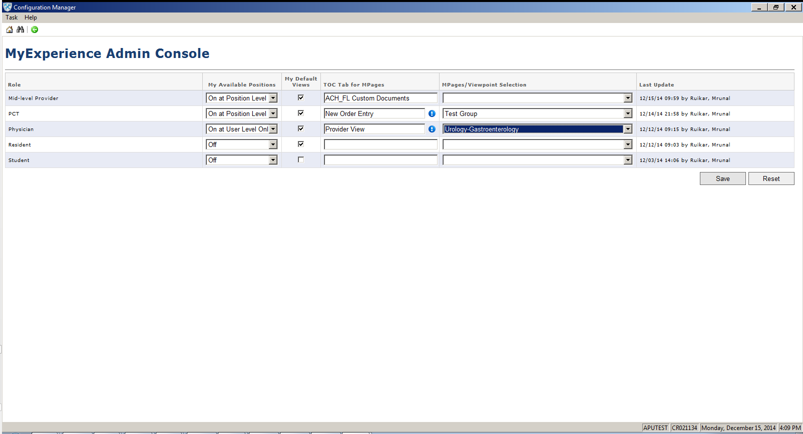
Users assigned to the role or users within positions related to the role are now enabled to switch any MPage/ ViewPoint in the selected group into the designated TOC tab.

Slide 58
PrefMaint
Add the MyExperience User Console to positions as an Organizer Level MPage

Slide 59
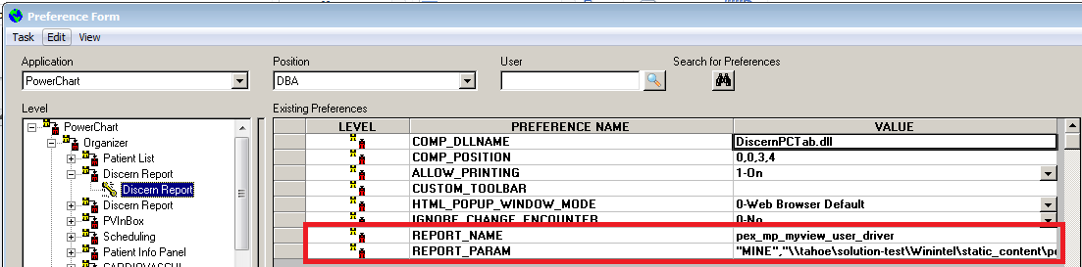
Last, the administrator must add the MyExperience User Console as an Organizer level MPage to the related positions of the roles. Once the MPage is added for one position, it can be easily copied to all other positions with the Position Comparison Utility.
REPORT_NAME = pex_mp_myview_user_driver
REPORT_PARAM = "MINE","<path to your specific content directory>\pex_mp_myview"

Slide 60


Benefits
Administrators allow different physicians different switching options
Physicians can quickly switch among their specialty positions and/or specialty views
Residents can remain in one position with resident privileges and access different specialty MPages when they rotate
Nurses can access different positions or views as they move to different units.
Notes:
MyExperience has powerful benefits for physicians and health care IT.

Slide 61



How can we install this?
MyExperience 1.0 is GA and requires the following
72165 – Physician Experience: Configuration Manager
74111 – Physician Experience: Configuration Manager (June 2014)
72537 – Physician Experience: MyExperience 1.0
78372 – MyExperience Position Change Dependency (December 2014) OR 78334 – MyExperience Shutdown Dependency (June 2014)
MyExperience 1.1 is Available for Validation and requires the following
72165 – Physician Experience: Configuration Manager
74111 – Physician Experience: Configuration Manager (June 2014)
77915 – Physician Experience: MyExperience 1.1
78372 – Physician Experience: MyExperience Position Change Dependency (December 2014)
Find more information on the MyExperience reference page: https://wiki.ucern.com/display/public/reference/All+About+the+MyExperience+User+Console+and+MyExperience+Admin+Console
Notes:
GA
Functionality you need:
72165 – Physician Experience: Configuration Manager
74111 – Physician Experience: Configuration Manager (June 2014)
72537 – Physician Experience: MyExperience
73384 – Physician Experience: MyExperience Shutdown Dependency
The estimated release date is June 2014.
https://wiki.ucern.com/display/public/reference/All+About+the+MyExperience+User+Console+and+MyExperience+Admin+Console

Slide 62
MyExperience
Physician Experience
Notes:
Cerner is committed to improving physicians’ experience through health information technology.

